Slide 1
Sentinel in Terraform Cloud
April - 2023

Slide 2

Table of contents
Introduction to Sentinel Policy
Creating Terraform Configuration File
Creating Sentinel Workspace and Generating Mocks
Writing Sentinel Policy for Terraform
Testing Sentinel Policy for Terraform

Slide 3

Introduction to Sentinel Policy

Slide 4
What is Sentinel?
HashiCorp's Sentinel is a framework for implementing governance policies as code in the same way that Terraform implements infrastructure as code.
It includes its own language and is embedded in HashiCorp's enterprise products.
It includes a CLI that allows you to test policies.

Slide 5
How Customers are Using Sentinel in Terraform
HashiCorp customers are using Sentinel to implement governance policies like the following in Terraform Cloud/Enterprise:
Enforce security standards:
Require all S3 buckets use the private ACL and be encrypted by KMS.
Restrict which roles the AWS provider can assume.
Prohibit specific resources, data sources, providers, or provisioners.
Avoid excessive costs:
Limit the sizes of VMs and Kubernetes clusters in public clouds.
Limit the monthly spend of each Terraform workspace.
Enforce mandatory tags on resources provisioned by Terraform.
Mandate that all modules come from a Private Module Registry.
Enforce specific Terraform coding conventions.

Slide 6
Sentinel Policy Enforcement Levels
Advisory
Only logs violations
Soft Mandatory
Can be overridden by authorized users:
Members of the owner's team
Members of teams with the "Policies Override" permission
Hard Mandatory
Cannot be overridden by anyone

Slide 7
Types of Terraform Sentinel Policies
There are essentially four types of Terraform Sentinel policies corresponding to the 4 Terraform Sentinel imports:
Policies can use the tfplan/v2 import to restrict specific attributes of specific resources and data sources in the current Terraform plan.
Policies can use the tfconfig/v2 import to restrict the configuration of Terraform modules, variables, resources, data sources, providers, provisioners, and outputs.
Policies can use the tfstate/v2 import to check whether previously provisioned resources or data sources have attributes with values that are no longer allowed.
Policies can use the tfrun import to check workspace and run metadata and whether cost estimates for planned resources are within limits.
Some policies might use more than one of these imports.

Slide 8



How Terraform Works With Sentinel
VCS
Terraform Cloud Workspace
Plan
Sentinel Policy Checks
Apply
Infrastructure
If cost estimates are enabled, they run right after the plan.

Slide 9
Sentinel Mocks in Terraform
Sentinel Mocks simulate the data that is made available to the Terraform Sentinel imports from Terraform plans.
They can be generated from recent plans using the Terraform Cloud UI and API.
They can also be copied and edited to simulate various combinations of resource and data source attributes.
They enable testing of Terraform Sentinel policies with the Sentinel CLI.
Using the Sentinel CLI with mocks speeds up development of new policies since additional plans do not need to be run.

Slide 10
Key Sentinel Language Constructs
Types: boolean, integer, float, string, list, map
A List is a collection of zero or more items
A Map is a collection of zero or more key/value pairs
Operators: Arithmetic, Logical, Comparison, Set, Matches, Else
Assignments: Set the value of variables.
If/Else and Case Statements: Specify conditional execution of different logic within a function
For Loops: Repeat statements while iterating over a map or list.
Frequently used inside functions
break and continue statements can alter loop execution.
The Filter quantifier expression that returns a subset of a collection.
Imports: Reusable libraries of Sentinel functions.

Slide 11
Sentinel Pre-declared Identifiers
Constants:
False
True
Null
Undefined
Type Conversion Functions:
bool
float
int
string
Other Builtin Functions:
append
delete
error
keys
length
print
range
values

Slide 12
Sentinel Numerical and Logical Operators
Arithmetic: +, -, *, /, and % (remainder)
p and q p and q must both be true
p or q at least one of them must be true
p xor q exactly one of them must be true
!p p is false
not p p is false

Slide 13
Sentinel Set Operators
Set operators can be applied to lists, maps and strings.
For strings, the set operators do substring inclusion
Examples for lists:
1 in [1, 2, 3] Means that 1 is in the list
[1, 2, 3] contains 2 Means that the list contains 2.
[] is empty Means that the collection is empty.
You can also use not in, not contains, and is not empty.

Slide 14
The Sentinel Matches Operator
The matches operator tests if a string matches a regular expression.
Examples:
"test" matches "^te" # true
"1352" matches "[0-9]*" # true
"123A" matches "[0-9]*" # false
"xyz.com matches ".*\\.com" # true
The strings import can also be used to determine if a string has a specific prefix or suffix

Slide 15
Common Operations of the Standard Imports
Check if a string has a prefix: strings.has_prefix(s, prefix)
Check if a string has a suffix: strings.has_suffix(s, suffix)
Check the type of a Sentinel object: types.type_of(obj)
Make external calls to API endpoints:
response = http.get("https://example.hashicorp.com")
Convert a JSON object to a Sentinel structure:
json.unmarshal(response.body)

Slide 16
Sentinel Functions
A Sentinel Function is declared with the func keyword.
find_resources = func(resource_type) {
# Do something and use the parameter
return true
}
Each function has a name such as find_resources.
Each function can have zero or more parameters.
The function above has the single parameter, resource_type
Every function must return a value such as true.
A call to this function could look like:
rds_clusters = find_resources("aws_rds_cluster")

Slide 17
Sentinel Modules
A Sentinel Module defines Sentinel functions and rules in a file that can be used by Sentinel policies with a single import statement.
This avoids the need to paste the functions into every policy that calls them, improving the reusability of Sentinel functions.
Sentinel modules are registered in Sentinel CLI configuration files and in TFC/TFE policy set configuration files.
The terraform-sentinel-policies repository includes 8 modules:
tfplan-functions, tfstate-functions, tfconfig-functions, tfrun-functions, aws-functions, azure-functions, gcp-functions, and registry-functions.
Each function is documented in a separate Markdown file.
Note that these are NOT standard functions.

Slide 18
The New Third-Generation Policies
The new third-generation policies were written in the spring of 2020 and use the new Terraform Sentinel v2 imports and Sentinel modules.
They have the following advantages:
Their use of the v2 imports and the Sentinel filter expression makes it easier to restrict policies to specific operations performed by Terraform.
The common functions defined in Sentinel modules do not need to be pasted into policies that use them.
Most of the policies do not have any for loops of if/else conditionals. This makes the policies easier to understand and copy.
They can evaluate the value of any attribute of any resource or data source, even those that are deeply nested.
However, since they do use the v2 imports, they can only be used with Terraform 0.12 and higher.

Slide 19
Creating Terraform Configuration File

Slide 20
Folder Structure
Documents
aws rds cluster
common functions
tfplan-functions
tfplan-functions.sentinel
test
restrict-aws-rds-cluster
fail.hcl
pass.hcl
mock-tfplan-fail.sentinel
mock-tfplan-pass.sentinel
main.tf
restrict-aws-rds-cluster.sentinel

Slide 21
Basic Methodology for Restricting Resources
The Eight Steps of the recommended methodology are:
Create a Terraform configuration that creates the resource.
Create a workspace that uses your Terraform configuration.
Run a plan against the workspace.
Generate mocks against the plan in the TFC UI.
Write a new Sentinel policy.
Create test cases and test your policy with the Sentinel CLI.
Revise your policy and test cases until the latter all pass.
Deploy your policy to a TFC organization.

Slide 22
Create a Terraform Configuration: main.tf
terraform {
required_providers {
aws = {
source = "hashicorp/aws"
version = "4.59.0"
}
}
}
provider "aws" {
# Configuration options
}
resource "aws_rds_cluster" "mycluster" {
cluster_identifier = "aurora-cluster"
engine = "aurora-mysql"
engine_version = "5.7.mysql_aurora.2.03.2"
availability_zones = ["us-west-2a", "us-west-2b", "us-west-2c"]
database_name = "mydb"
master_username = "admiin"
master_password = "password"
backup_retention_period = 5
preferred_backup_window = "07:00-09:00"
}

Slide 23
Creating Sentinel Workspace and Generating Mocks

Slide 24
Create a Workspace in the TFC/TFE UI
Create a Terraform Cloud account
Verify your email
Create a organization in Terraform Cloud
Create a Workspace using the Version control workflow (GitHub)

Slide 25
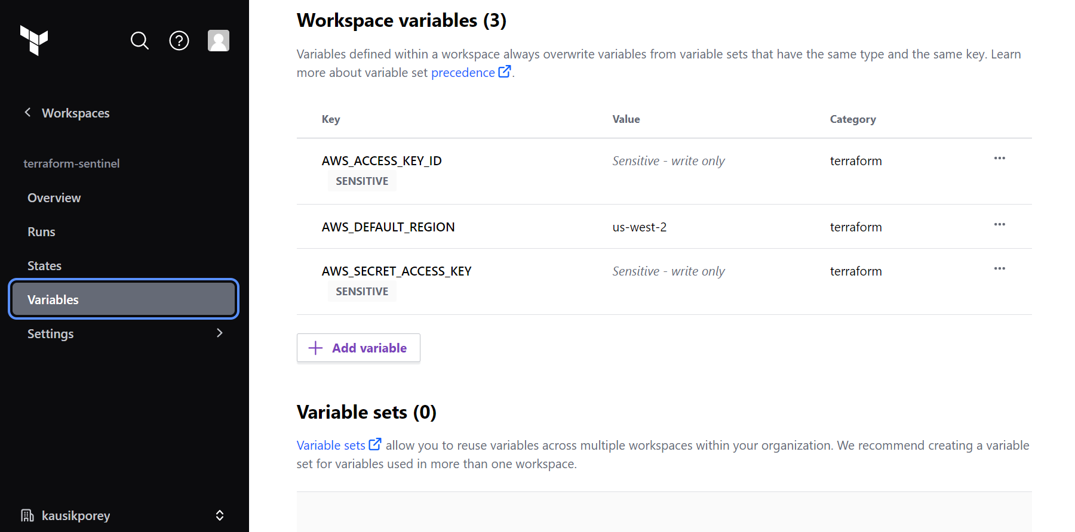
Set Variables in Your Workspace

Slide 26
Run a Plan and Generate Mocks Against It
Open your Terraform Cloud and run a plan against your configuration.
To generate mocks against your plan, click the "Download Sentinel mocks" button.
After a minute, a tar.gz file will be downloaded with 7 mocks.
Extract the mock files from the tar.gz file.

Slide 27
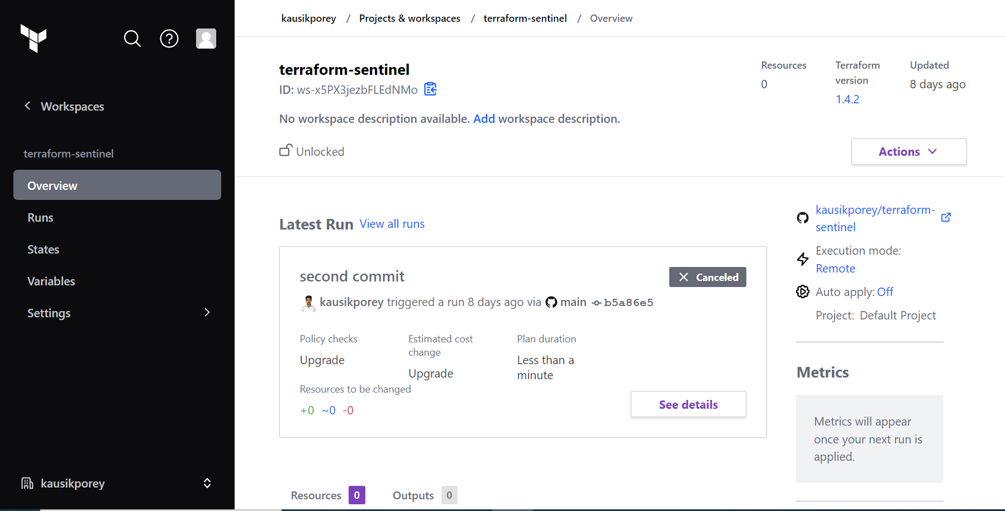
Run a Plan

Slide 28
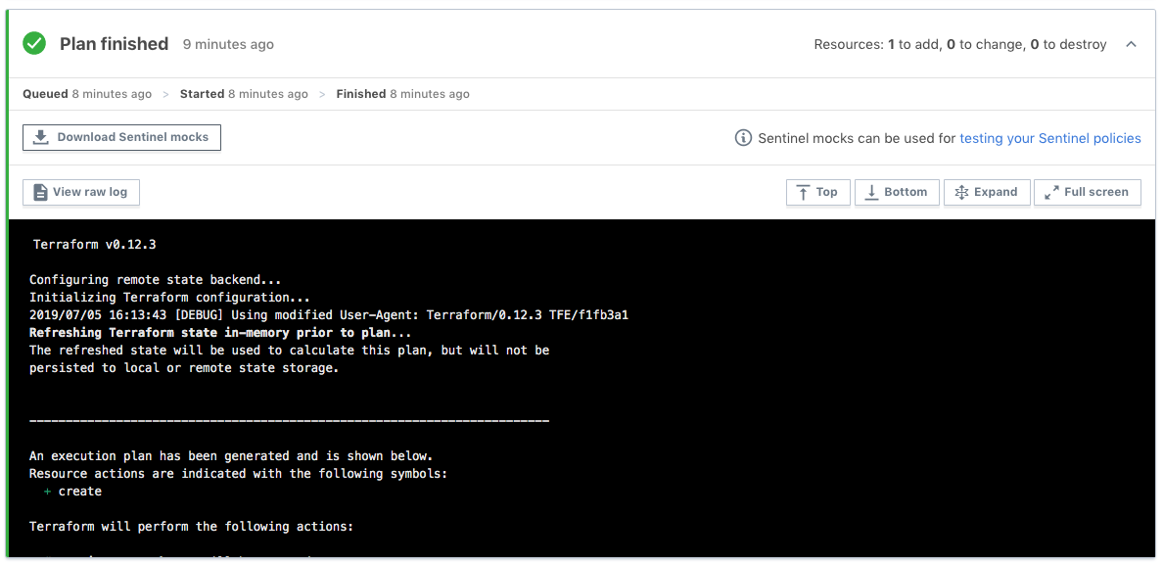
Generate Mocks Against Your Plan

Slide 29
Writing Sentinel Policies for Terraform

Slide 30
Write a Terraform Sentinel Policy
In this slide, we will create a Sentinel policy called "restrict-aws-rds-cluster.sentinel" that restricts the AWS RDS Cluster if a specific backup retention period is not set.
# Imports common-functions
import "tfplan-functions" as tfplan
# Store the minimum retention period in a varibale
minimum_retention_period = 7
# Get all RDS Clusters
rds_clusters = tfplan.find_resources("aws_rds_cluster")
# Return all the rds_clusters that violate the rule
# "AWS RDS clusters have a backup retention period set to at least 7 days."
violating_resources = tfplan.filter_attribute_less_than_value(rds_clusters, "backup_retention_period", minimum_retention_period, true)
# Main rule
main = rule {
length(violating_resources["messages"]) is 0
}

Slide 31
Common Functions
The Instruqt track in this workshop embeds two Sentinel modules with many common functions that can be used in policies.
These are copies of the functions located here.
The policy we just examined called the following functions:
find_resources(type)
filter_attribute_not_in_list(resources, attr, allowed, prtmsg)
There are other find and filter functions in the above modules.
The filter functions print all violations if prtmsg is true.
Additionally, the filter functions call a very useful function:
evaluate_attribute(r, attribute)

Slide 32
Set Up the Test Cases Directory for the CLI
To test your policy with the Sentinel CLI, you first need to set up test cases that use the tfplan/v2 mock you generated earlier.
Under the directory containing your policy, create a test directory.
Under the test directory, create a directory with the same name as your policy, but without the ".sentinel" extension.
So, for our restrict-aws-rds-cluster.sentinel policy, we create the restrict-aws-rds-cluster directory under the test directory.

Slide 33
Copy Mocks and Create Test Cases
Copy the mock-tfplan-v2.sentinel mock file that you downloaded and extracted from your workspace.
Paste it inside the test/ restrict-aws-rds-cluster folder
Change the name of the mock file to mock-tfplan-pass.sentinel.
Create a second copy of the file called mock-tfplan-fail.sentinel.
Create pass.hcl and fail.hcl files that have the text on the next two slides respectively.

Slide 34
The pass.hcl Test Case
module "tfplan-functions" {
source = "../../common-functions/tfplan-functions/tfplan-functions.sentinel"
}
mock "tfplan/v2" {
module {
source = "mock-tfplan-pass.sentinel"
}
}
test {
rules = {
main = true
}
}

Slide 35
The fail.hcl Test Case
module "tfplan-functions" {
source = "../../common-functions/tfplan-functions/tfplan-functions.sentinel"
}
mock "tfplan/v2" {
module {
source = "mock-tfplan-fail.sentinel"
}
}
test {
rules = {
main = false
}
}

Slide 36
Edit the Pass and Fail Mocks
Edit the mock-tfplan-pass.sentinel mock file and make sure that all values of backup_retention_period are set to a value such as “8".
Edit the mock-tfplan-fail.sentinel mock file and make sure that at least one value of backup_retention_period is set to a value such as “5".
You should always have at least 1 fail and 1 pass test case.
Sometimes, you will want multiple fail test cases and corresponding mocks.
You might even want more than 1 pass test case and mock.

Slide 37
Testing Sentinel Policies for Terraform

Slide 38
Test Your Policy with the CLI
Now that you have set up your test cases, you can test your policy with the Sentinel CLI.
Navigate back to the directory containing your policy.
Run the following command:
sentinel test restrict-aws-rds-cluster.sentinel
To see the outputs of the print statements, change this to:
sentinel test –verbose restrict-aws-rds-cluster.sentinel
You can also apply a policy with the sentinel apply command, but you must set up a Sentinel configuration file like the "sentinel.json" file downloaded with the mocks or a "sentinel.hcl" file.

Slide 39
Test Your Policy with the CLI
The first command gives:
PASS - restrict-aws-rds-cluster.sentinel
PASS - test\restrict-aws-rds-cluster\fail.hcl
PASS - test\restrict-aws-rds-cluster\pass.hcl
1 tests completed in 65.1921ms

Slide 40
Testing Policies in Terraform Cloud
After successfully testing a policy with the CLI, you might also want to test it against actual Terraform code on a TFC or TFE server.
When doing this, we suggest you follow these recommendations:
Put each new policy in a policy set that does not contain any other policies.
Assign the workspaces you will be using to test your policy to that policy set.
Do not assign any other workspaces to the policy set.
Set the policy enforcement level to hard mandatory.
Following these recommendations will make your testing easier:
You won't see results from other policies.
You won't have to worry about overriding soft-mandatory failures.

Slide 41


Slide 42
EY | Building a better working world
EY exists to build a better working world, helping create long-term value for clients, people and society and build trust in the capital markets.
Enabled by data and technology, diverse EY teams in over 150 countries provide trust through assurance and help clients grow, transform and operate.
Working across assurance, consulting, law, strategy, tax and transactions, EY teams ask better questions to find new answers for the complex issues facing our world today.
EY refers to the global organization, and may refer to one or more, of the member firms of Ernst & Young Global Limited, each of which is a separate legal entity. Ernst & Young Global Limited, a UK company limited by guarantee, does not provide services to clients. Information about how EY collects and uses personal data and a description of the rights individuals have under data protection legislation are available via ey.com/privacy. EY member firms do not practice law where prohibited by local laws. For more information about our organization, please visit ey.com.
Ernst & Young LLP is a client-serving member firm of Ernst & Young Global Limited operating in the US.
© 2022 Ernst & Young LLP. All Rights Reserved.
2022-3988662 ED None
This material has been prepared for general informational purposes only and is not intended to be relied upon as accounting, tax, legal or other professional advice. Please refer to your advisors for specific advice.
ey.com

